Slide 1
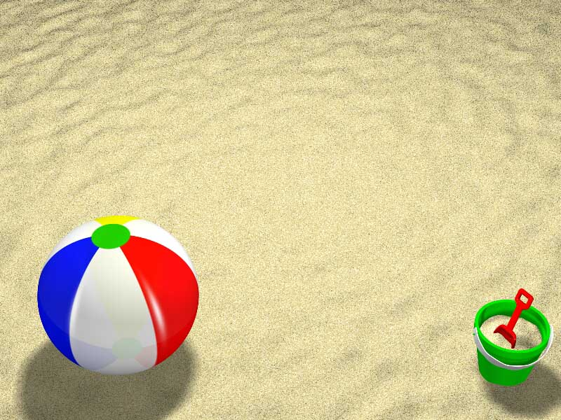
To BICA and Beyond:
Rah-Rah-Rah!
--or--
How biology and anomalies together contribute to flexible cognition
Don Perlis
University of Maryland

Slide 2

Preamble
AI has learned this: reality does not come in a nice neat bundle of well-defined entities and behaviors as in chess or blocks worlds.
Yet our programs tend to be modeled on neat bundles and so encounter the brittleness problem: the they break in the face of even slight deviations from anticipated circmumstances.

Slide 3
Acknowledgement
Collaborators: Mike Anderson, Darsana Josyula, Tim Oates, Scott Fults, Matt Schmill, Shomir Wilson, Hamid Shahri, Dean Wright, Percy Tiglao,
Thanks for support from NSF, ONR, AFOSR

Slide 4
Efforts to get past brittleness--e.g., learning, probabilities, nonmonotonicity--have not been even remotely successful at exhibiting human flexibility of coping, or indeed almost any degree of coping at all.

Slide 5
Outline
Rational anomaly handling
Why it has been so hard
How biology does it
RAH Principles
RAH Progress

Slide 6
Anomalies
Any fixed characterization of commonsense reality fails at some point: something unexpected occurs, and a system response--not system reprogramming--is needed.

Slide 7
Rational anomaly handling
Somehow we respond to anomalies very effectively and robustly.
What do we have that our automated systems do not…
…and why has it been so hard to discover and automate?

Slide 8
Biology to the rescue, I
How do species survive in a world that can change suddenly and irregularly?
They often don’t---and those that do tend to do so by slowly adapting, not unlike adaptive systems: many individuals fail, but the species succeeds.
This is a generational process, not individual handling of an individual anomaly on the fly.

Slide 9
Biology part II
Yet we as a species have developed RAH. Can we get a handle on its chief features?
Or might it not have any chief features, no concise intelligible principles, just a mish-mash of many special-purpose happenstance tricks, a muddling-through that has been distributively encoded into our brains with no underlying architecture?

Slide 10
Biology part III
There is compelling evidence for a principled architecture, right in our everyday activity.
What do we do when faced with an anomaly? The answer is quite straightforward: We notice it, and deal with it.

Slide 11
No joke
Noticing an anomaly is half the battle. And dealing with it is easier than it may seem.

Slide 12
How we notice an anomaly
Have expectations as to how certain aspects of the world work
Have sensors that can detect those aspects at work.
Have a process that can compare the two and record a mismatch.

Slide 13
Expectations
Can include aspects of self, e.g., goals, and expected outcomes of one’s actions.
Where do expectations come from?
Some might be built in, others learned (by training, inference, or being informed).

Slide 14
How we deal with anomalies
No need to be clever. Instead use SATIRE (ok, that’s a joke):
Stop (working on whatever it is)
Ask for help
Train (if poor ability is at issue)
Ignore an anomaly as unimportant
Retry (maybe it’ll work next time)
Experiment (cast about, see if something else works)
Notes:
Of these, all but Ask and Train are probably available to pre-RAH biological organisms

Slide 15
What happens when a particular type of anomaly has been encountered several times and a successful approach learned, perhaps by training?

Slide 16
It no longer is an anomaly: one now expects that sort of thing and knows what to do
The learning/training phase is turned off

Slide 17
Overall assessment
SATIRE works well in humans, a very great deal of the time.
Why has this been so elusive?
Can it be automated?

Slide 18
Elusivity
Temptation by sirens of simplicity
Bank hopes on adaptive systems
Stigma of contradiction
Notes:
Nonmon etc held out hope of nice bundles after all, and was such a nifty thing to study!
Adaptive systems seemed to promise everything, correctly, but slow and without guidance
Anomalies seem a bit like logical contradictions, things to avoid -- yet anomalies noticed are best friends

Slide 19
Automating RAH: the Metacognitive Loop (MCL)
Have expectations
Compare to observation
Assess the discrepancy in terms of any available explanation, strategy, and importance
Invoke one or more of Stop-Ask-Train-Ignore-Retry-Experiment
Revise expectations as needed

Slide 20
MCL
Clearly necessary
Allows testing sufficiency

Slide 21
And that’s it!
It works (we do this every minute of every day) and can be automated.
Caveats:
--It does not solve tricky problems -- for that we need domain expertise (but we also know how to automate that).
--It does not shape new world views (that is discovery or genius, not commonsense).

Slide 22
Are we there yet?
No, but promising work has been done and more is underway

Slide 23
Our current version of MCL
Succesful application to reinforcement learning, navigation, NLP, nonmon, video-arcade tank game playing.

Slide 24
Work underway toward Universal MCL
Domain independent ontologies of anomalies, explanations, and responses
Interface to any system

Slide 25
Current aims
A sort of Map-task corpus on grand scale:
Human to automated central command via NLP
Central command to Mars Rover
Central command to Afghanistan

Slide 26
Schematic:
Human (with natural RAH)
<-->
NLP/CSR (+ MCL)
<-->
remote agents (+ MCL)
Notes:
Simbots and also physical bots at NRL

Slide 27
Future work: Universal to specialized MCL
Once attached to a host, an instantiation of MCL becomes adapted to host and domain
Need for trainable modules, training algorithms, organized memory

Slide 28
The End
Thanks for listening.

Slide 32
Results to date
MCL-enhanced reinforcement learning

Slide 33
Principles, II

Slide 34
Principles, III

Slide 35
Principles, IV

Slide 36
Principles, V

Slide 37
Working synergistically

Slide 38
Progress

Slide 39
Reinforcement Learning

Slide 40
Tank game

Slide 41
Natural language

Slide 42
Universal RAH

Slide 43
Universal specializaton

Slide 44
Reasoning and meta-reasoning

Slide 45
Anomalies within RAH

Slide 46
Conclusions

